Slide 1
EP011
EPIC:
Application Submission.

Slide 2
EP011: Application Submission
Story ID: EP011-S001-PK:
As a Easy Finance App User, I want to submit my loan application from App so that my loan Application for purchasing a new BMW Vehicle be can be evaluated by BMW - Dependency with Epic 10 (Document Handling).
Story ID: EP011-S002-PK :
As a Easy Finance App User I want to view my submitted application status in App so that I can take next step based on BMW Evaluation. Dependency with Story EP011-S001-PK.
Story ID: EP011-S003-PK : (This Story will be handled from DFE)
As a Easy Finance App User I want to submit my returned loan application from App so that my vehicle loan application can be reevaluated by BMW. Dependency with Story EP011-S001-PK; Dependency with Story EP011-S002-PK.
Note: when the application is returned, it is decided by business to allow F&I in Dealership to review the comments & reason for return and assist the customer will application process.

Slide 3
Story ID: ES-S001:
As a Easy Finance App User, I want to submit my loan application from App so that my loan Application for purchasing a new BMW Vehicle be can be evaluated by BMW - Dependency with Epic 10 (Document Handling).
Assumptions:
User has passed/completed all the steps before document handling and has uploaded all necessary documents as needed.
User is Using Easy Finance App to submit the Loan Application for BMW Evaluation.
Pre-Conditions:
Easy Finance App user has filled in all mandatory information and completed all necessary steps before application Submission.
Easy Finance App user have to receive SMS / Push notification upon Application Submission from Easy Finance App.
Fixed Application Status is Synchronized across various systems involved i.e., DFE, Easy Finance APP Administration portal and Easy Finance App etc.,
Acceptance Criteria:
The story is complete when below criteria are met:
Easy Finance App user is faced with options to Submit Application and proceed to next phase with a Submit, Back & Cancel buttons. F&I WILL NOT review & approve the final application that is submitted to GCAP by customer.
Application Status is set to “Application Submitted” and prompted to Potential Customer.
BMW’s Internal SF Application GCAP will receive request submitted by Potential customer from Easy Finance App.
GCAP Automatically reviews the application with pre-set BMW SF’s Business Policy Rule Matrix to Evaluate application.
Based in GCAP’s Evaluation Application Status is set to one of the 3 status below,
Auto Approved (or) Auto Declined (or) Send Back: Add Co-borrower/Guarantor (or) MUW
Business
Security
Compliance
DFE IT/Biz

Slide 4
（Cont.）Story ID: ES-S001:
Business
Acceptance Criteria
Potential customer is notified with SMS & push notification from easy finance app about his/her application status change. Same status is sync-ed & maintained at DFE, APP frontend and in app admin portal for future references.
When status = Auto Approved.
Customer continues to proceed with vehicle purchasing process at the dealership and application status is set
As Accepted & Processing
Potential customer is provided with hotline number in application status check page and in notification SMS to reach out to for application support if any support needed from customer interaction center.
When status = Auto Denied.
Easy Finance App user is allowed to start a new Application process but not allowed to edit the Denied Applications.
Important Note: History records to be maintained for future reference - Thus not allowing Customer to edit the denied applications. If time and resource permits a functionality such as Creating a new Application from old application can be build and made available
When status = Send it back: Add Co-borrower or Guarantor: (Story Dependency: EPIC 9).
Potential Customer can invite a co-borrower to join the application process. Potential customer can also have to option to complete rest of the process from DFE. E-Authentication is conducted in Easy Finance App and F&I Assist customer when & where needed. All Status & Comments are synced with DFE & Easy Finance App.
When status = MUW (Manual Under Writing).
Current CA process is followed and notified to user with ca’s feedback as necessary. A note/remark section is added in GCAP to collected CA process feedback and sync with DFE and Easy Finance App. Customer Continues the process from DFE with F&I’s Assistance.
Security
Compliance
DFE IT/Biz

Slide 5
Status Maintained in various Application Stages
Easy Finance App follows below agreed Status as Loan application is review & processed;
Quotation Draft: When the App user is selecting products and generating quotation.
Quotation Created: When Quotation is reviewed & Approved by Dealer F&I.
E-Authentication: When App user is authenticating him/her – self from Easy Finance App’s E-Authentication service.
Pre-Check Processing: When the App user is under going pre-check process.
Pre-Check Pass: This status is set when App user Passes Pre-Check Process.
Pre-Check Fail : This status is set when App user fails Pre-Check Process.
Application Draft: While App user is filling in the Application and not proceeded to doc. handling.
Document Upload: While App user is uploading Necessary docs for application.
Application Submitted: While Application is Submitted.
Auto Approved: When GCAP Auto Approved Application.
Auto Denied: When GCAP Auto Rejected Application.
Returned: When GCAP Returned Application due to insufficient Credit Scoring – Co-Borrower needed.
Application Processing: Application Accepted for Loan Processing.
MUW: When the Application is forwarded for manual under wrting.

Slide 6
Story ID: EP011-S001-PK:
Mockups:
Congratulations!!!
Your BMW Easy Finance Application has been Submitted Successfully.
Come Back Check your Application Status!
Call Us if you had any Queries
Helpline: XX-XXXX-XXX
Document Handling Page.
This is where all the uploaded Documents are previewed & Approved.
Product Data is Previewed
E Authentication Status is Previewed
Application Data is Previewed
Document Uploaded are Previewed
Close & Go to Home
Submit Application
Check Application Status
Cancel & Set Status to Draft
Proceed to Submit

Slide 7
Story ID: EP011-S001-PK: Mockups: Application reviewed in DFE.
Dealer Front End
Not Needed as per Business Decision
Application Data:
Application Profile Data
Product & Binding Offer Data
Authentication / Authorization & Review Data.
++Attachments
Application Status
Submitted
Approve
Return for Update
Cancel Request

Slide 8
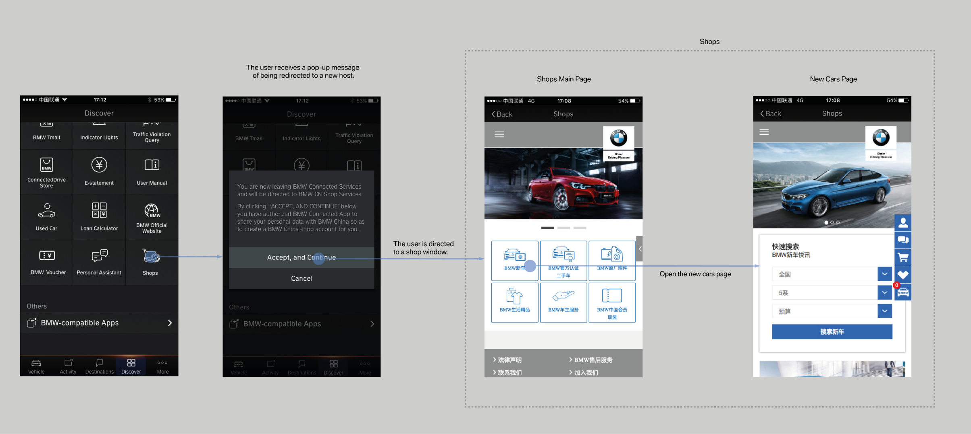
Story ID: EP011-S001-PK:
Wireframes
Sample

Slide 9
Story ID: EP011-S001-PK:
OWNER: IT ARCH.
Process Flow:
Easy Finance APP
Application
Submission
User A
Customer Finishes Document upload.
All Mandatory docs are uploaded after DFE review.
Customer
Clicks Submit.
DFE
GCAP
DFE
Application Data
Pushed to GAP without DFE Check
GCAP Runs the Scoring
& Policy Rule Matrix.
Data Synced
To DFE
Review Data Sync
to DFE
Customer
Receives SMS
& Push Notification
Return Responds to APP
CA process Status Shared

Slide 10
Story ID: EP011-S002-PK :
Business
As a Easy Finance App User I want to view my submitted application status in App so that I can take next step based on BMW Evaluation. Dependency with Story EP011-S001-PK
Assumptions:
User has pre-installed the Easy Finance App in his/her mobile devices.
User has Active Internet Connection & Telecom Connection.
User Accepted T&C to receive SMS & App push notifications.
Pre-Conditions:
User Must have submitted Loan application using Easy Finance App.
User Must have an open application that is submitted and waiting Feedback from BMW and (or) from BMW Dealer.
Acceptance Criteria:
The story is complete when below criteria are met:
User is able to view his/her application status in real-time with push notification & SMS Notifications.
Ref. to Mockup for more details.
Security
Compliance
DFE IT/Biz

Slide 11
Story ID: EP011-S002-PK :
Mockups:
Application Detail Page View
My Open Applications
Product Data is Previewed
Application #3424324
Submitted: 2018/10/14 Submitted
E Authentication Status is Previewed
Application #5345345
Submitted: 2018/10/14 Approved
Application Data is Previewed
Application #0957867
Submitted: 2018/10/14 Denied
Document Uploaded are Previewed
Close & Go to Home
Home
Status
Chat
Me
…

Slide 12
Story ID: EP011-S003-PK :
Business
As a Easy Finance App User I want to submit my returned loan application from App so that my vehicle loan application can be reevaluated by BMW.
Story Revision: When the application is returned; F&I assist customer to Continue the application process from DFE
Assumptions:
Users Initial Independent Application or application with borrower submitted has been returned to application due to
insufficient Credit Score or insufficient proof documents.
Pre-Conditions:
User ust have submitted Loan application using Easy Finance App.
User Must have an open resubmitted application that is submitted and waiting Feedback from BMW and (or) from BMW Dealer.
All the application request that is returned or set to MUW will be processed by DFE and DFE is build with features to have latest status from Easy Finance App and GCAP after evaluation.
DFE is extended with new features to allow customer to continue the application process from DFE when the application is returned or went for MUW.
Acceptance Criteria:
The story is complete when below criteria are met:
The user is allowed to resubmit the Returned applicant with co-borrower’s information and proof documents for review.
Refer to Story EP011-S001-PK & EP011-S002-PK for Co-Borrower and Guarantor process.
F&I do not review & approve the final application that is submitted by customer. Refer to Mockup for more details.
Security
Compliance
DFE IT/Biz

Slide 13
Story ID: EP011-S003-PK (Cont.):
Business
Acceptance Criteria:
When the application is returned or went to MUW, Customer is notified in Push notification in App & SMS.
Status from GCAP is synchronized to Easy Finance and DFE.
Customer is allowed to request support from F&I when he/she is at the dealership.
Security
Compliance
DFE IT/Biz

Slide 14
Story ID: EP011-S003-PK :
Mockups:
My Open Applications
Application #3424324
Submitted: 2018/10/14 Submitted
Application #5345345
Submitted: 2018/10/14 Approved
Application #0957867
Submitted: 2018/10/14 Denied
Home
Status
Chat
Me
…

Slide 15
Story ID: EP011-S003-PK :
Dealer Front End
Application Data:
Application Profile Data
Product & Binding Offer Data
Authentication / Authorization & Review Data
++Attachments
Application Status
Returned
Resubmit
Cancel Request

